Slide 1

Customer Review Classifier Project
Submitted By: Nihal Singh

Slide 2
Introduction:
Customer Review Classifier Model Project includes the details about the review of customers for different products like Mobile, Smart watch, laptops etc. on different shopping websites.
Customer Review model is used to predict the various reviews given by people on the E-commerce platform and predict the rating as per review given.
The model is build by working on multiple models and finalizing the one best model after working on data.
For building the model performing data cleaning, EDA, data preprocessing, model building and saving the model.

Slide 3
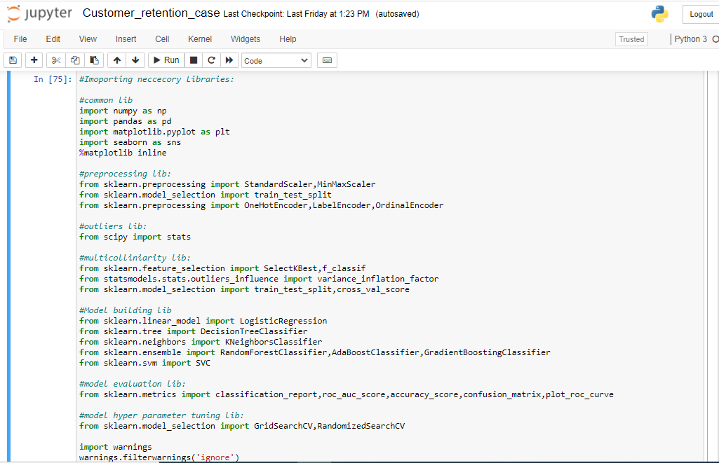
Importing Libraries:
Importing the Libraries used for EDA, data preprocessing and model building.

Slide 4
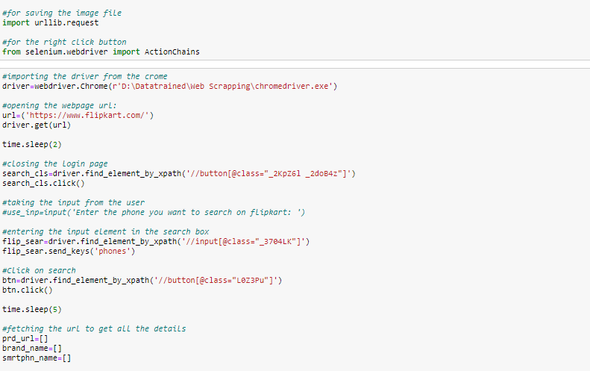
Using Selenium to fetch the Data:
Selenium Web driver is used to fetch the data from multiple web sites.

Slide 5
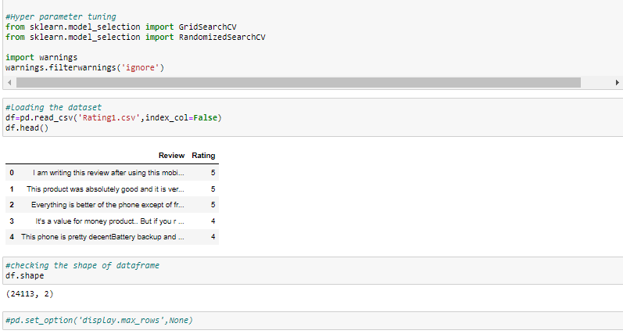
Fetching the Data frame:
Using the pandas library to import the data frame from csv file to data frame.
The library has been used read_csv.

Slide 6
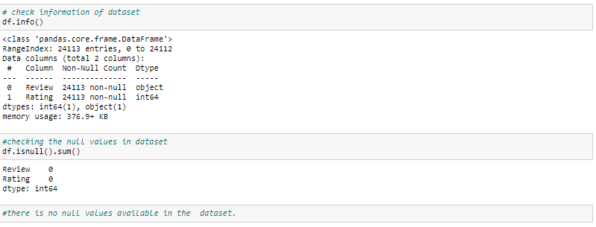
Checking the Shape and info of Data Frame:
Checking the shape of the Data frame using the .shape method.
The shape of the given data frame is (24113,2)
Checking the datatype information about the data frame using the info method.

Slide 7
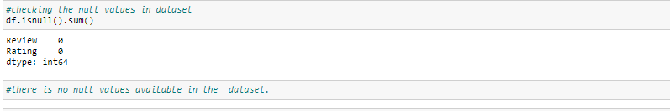
Checking the Null value count in Data frame:
Checking the null value count from every column of data frame.
Using the isnull().sum() method to check the null values. There is no null values in columns.

Slide 8
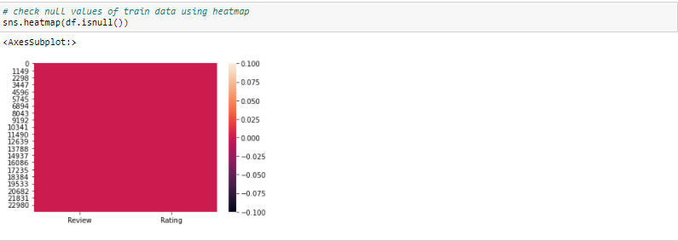
Checking the Null value using Heat map:
Checking the null value count from every column of data frame using the heat map.
Using the seaborn library and using the heat map from the library. There is no null values present in the given data frame.

Slide 9
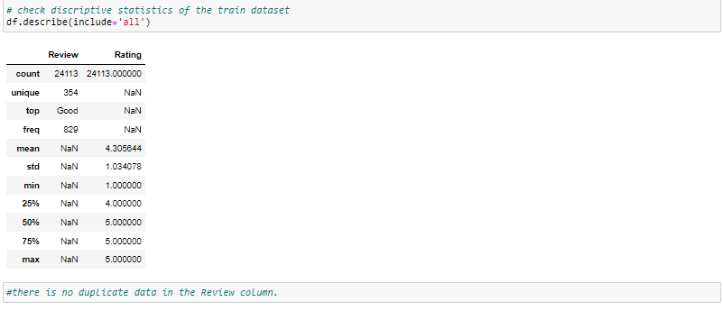
Using Describe Method to describe the data frame:
Using the describe method to describe the numerical columns.Describe method
only work on the numerical data features.
Describe is basically provide the count,mean,standered deviation,min max and quantile details of the columns data.it can be display using df.describe().

Slide 10
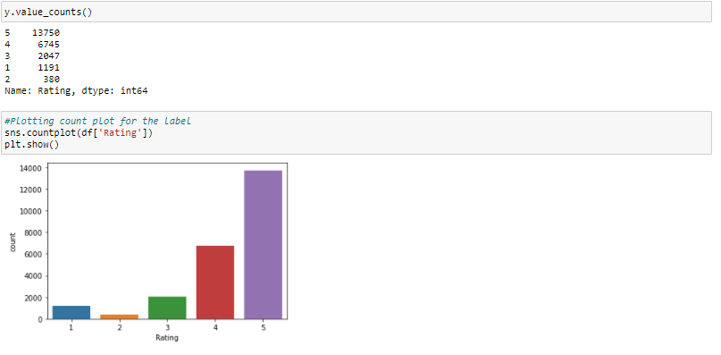
Plotting the Count Plot:
Using the count plot to plot the count ratio of every rating comments.
The count plot shows the ratio between outcomes.

Slide 11
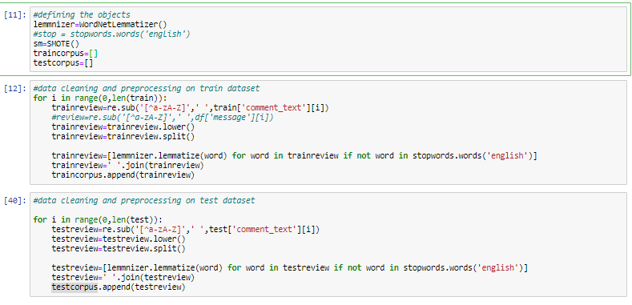
Using WordNetLemmatizer and stopwords to clean the text comment data:
The feature only contains the text comment which needs to filter and convert into the vectors for the model building.
Using WordNetLemmatizer and stopwords to fliter the text comments so the data should be converted in vectors.

Slide 12
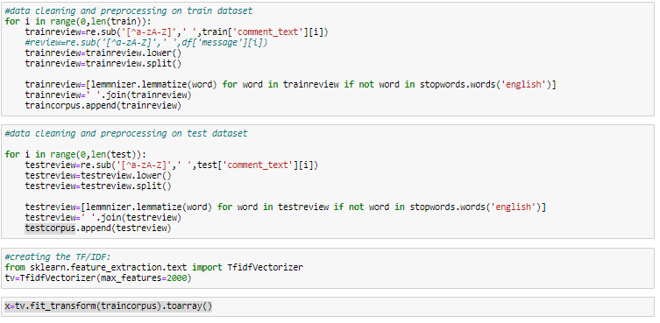
Converting words in to vectors:
Using the TF-IDF method to convert the filtered word into the vectors so after conversion features is ready for the model building.
TF_IDF method is basically read the words and convert it into sequence pattern in the numeric.
Max_features has been used to restrict the

Slide 13
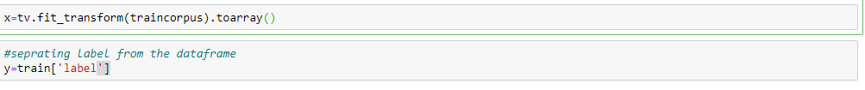
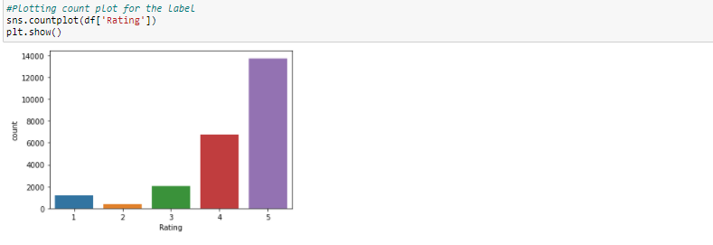
Separating the feature and target to build the model:
Separating the target and features variable in x and y variable to build the model.
It is a classification model as target variable having only five outcomes.

Slide 14
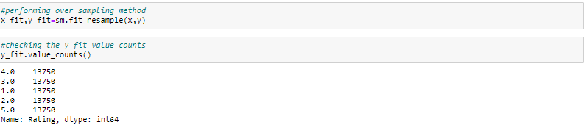
Checking Class imbalanced:
Class imbalanced issue occurs in classification model if the target variable having the imbalanced data.
Model having the class imbalanced issue so performing the up sampling to solve the class imbalanced issue.
Up sampling can be performed using the SMOTE.
.

Slide 15
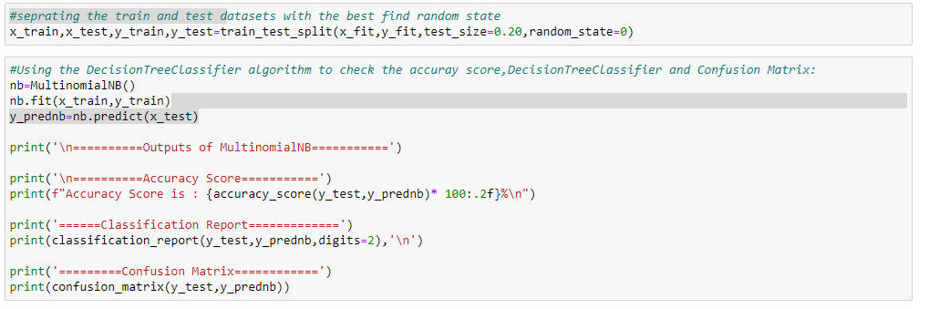
Training the model Using Train Test Split:
After the EDA and data preprocessing training the model using the train test split method.
The training the model into x_train, y_train, x_test and y_test.
Using the train test split training getting the x_train and y_train and fitting the model.

Slide 16
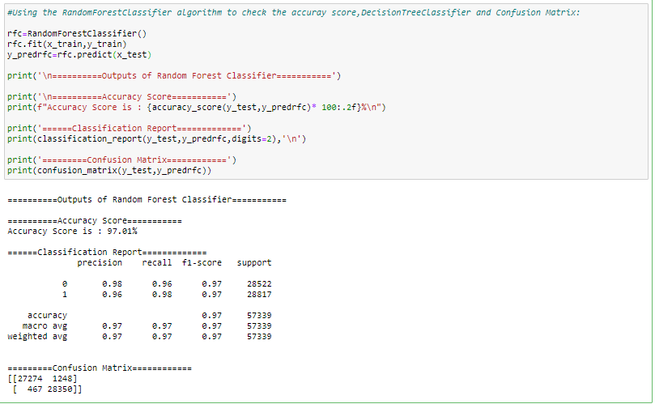
Building the multiple Models:
After the test_train_split, building the model using the test data.
Building all the classification models like MultinomialNB ,, AdaBoostClassifier, RandomForestClassifier, Logistices Reggression.
Training all the classification on train and test data and finding the accuracy.

Slide 17
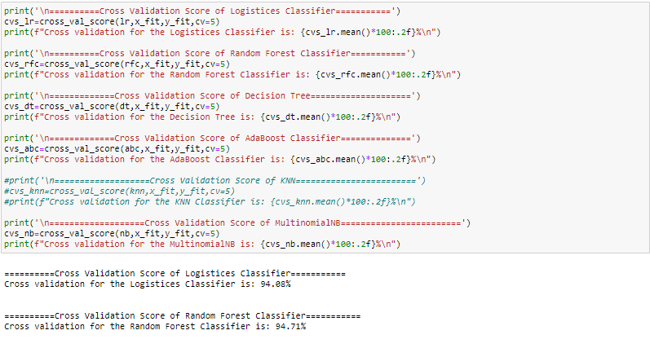
Performing Cross validation score:
After building the multiple models and getting the accuracy performing the cross validation score on all the models.
Cross validation is basically used to check the model is under fitting or over fitting on the test data.

Slide 18
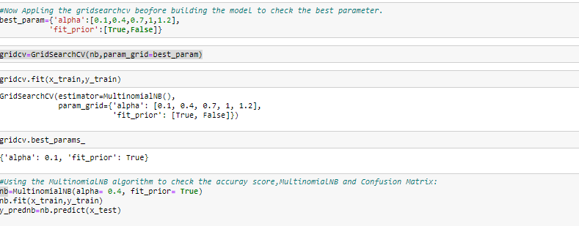
Hyper Parameter Tuning:
Selecting MultinomialNB as a best model as it has 90% score and No difference between accuracy and cross validation score.
Hyper parameter tuning having multiple parameters and selecting the best parameter for the model.

Slide 19
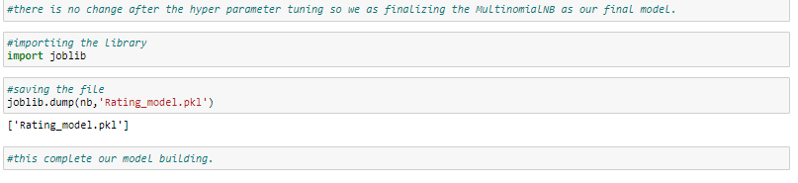
Saving the Model:
After the model building saving the final model in the pkl file.
This complete the model building.

